Slide 1

Comprehensive Movie Industry Insights:
A Multidimensional Overview
ALAKA P
ANN MATHEW
NAVYA MARIA JOMY
PHILSY V MARTIN

Slide 2
To explore the relationship between movie budgets and revenues, analyzing how financial investments affect profitability and identifying key financial trends and successful films across different decades.
1
To analyze the evolution of the movie industry over time, focusing on genre-specific financial performance, popularity trends, and overall industry growth from 1916 to 2016.
2
Objectives
To evaluate the performance of production companies in terms of revenue, profitability, and popularity, identifying key industry players and their impact on the movie landscape from the 1990s to the 2010s.
3
To assess how different genres and production companies influence audience engagement and popularity, examining trends in audience interaction, vote averages, and genre performance over the decades.
4

Slide 3






Dataset Description
1
Dataset Name: TMDB 5000 Movie Dataset
2
Source: Kaggle, originally from The Movie Database (TMDb)
3
Rows: 4,803 (each row likely represents a unique movie)
4
Columns: Multiple columns covering various aspects of each movie:
Budget, Genres, Homepage, ID, Keywordst, Original Language, Original Title: The original title of the movie, Overview, Popularity, Production Companies, Production Countries, Release Date, Revenue, Runtime, Spoken Languages, Status, Tagline, Title, Vote Average, Vote Count

Slide 4

Updated Financial Data
Genre Information
The revenue figures appear to be more current than in previous versions, potentially providing a more accurate representation of each movie's financial performance.
The dataset includes binary indicators for various genres, allowing for easy categorization and analysis of movies by type.
Dataset Features
Production Details
Keywords and Themes
Information about production companies and countries is included, offering insights into the global nature of film production.
There's a column for keywords, which likely describes themes, plot elements, or other notable features of each movie.

Slide 5


Statistical Overview
3,95,09,78,47,444
Total Revenue
Total Profit
2,55,59,45,20,923
106.9 minutes
Average Runtime
Average Age
21
Avatar
Top Movie
Top Movie Revenue
2,787,965,087
4803
Movie Count
Total Companies
1313

Slide 6

1
Overview
2
Financial Analysis
3
Temporal Trends
Dashboards
(Stories)
4
Production Company
5
Audience Reception

Slide 7

OVERVIEW

Slide 8
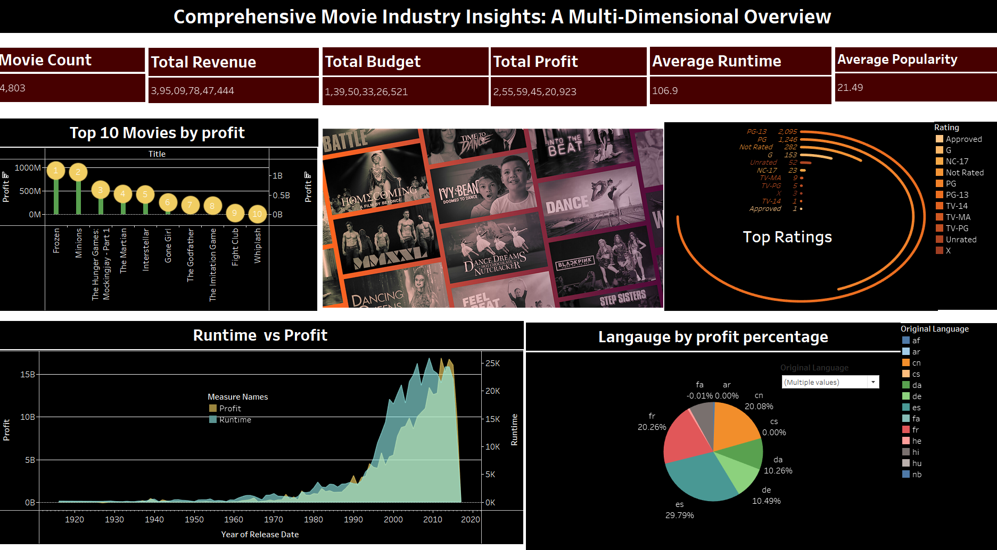

Slide 9
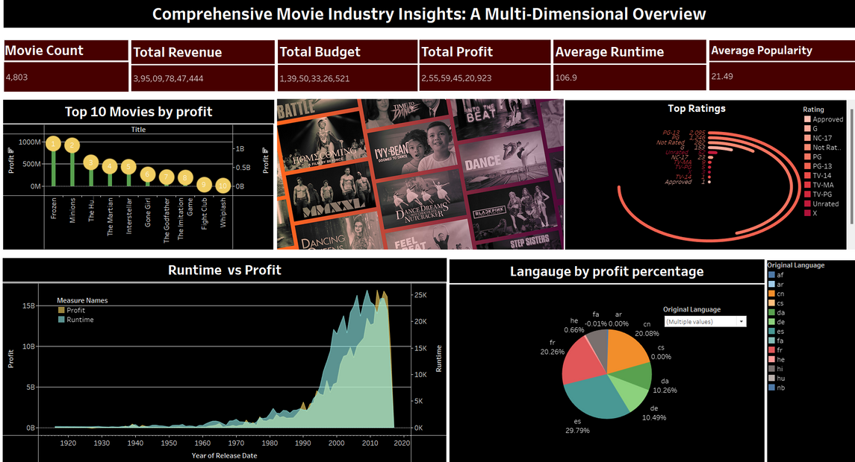
Overview
DESCRIPTION
Focuses on key metrics such as Movie Count, Total Revenue, Budget, Profit, Average Runtime, and Popularity.
Features visualizations like the "Top 10 Movies by Profit," with "Frozen" leading, a chart on movie ratings dominated by PG-13 and PG, and a "Runtime vs Profit" graph that tracks profitability trends over time.
Additionally, a pie chart shows profit distribution by movie language, highlighting English and French.

Slide 10

FINANCIAL ANALYSIS

Slide 11
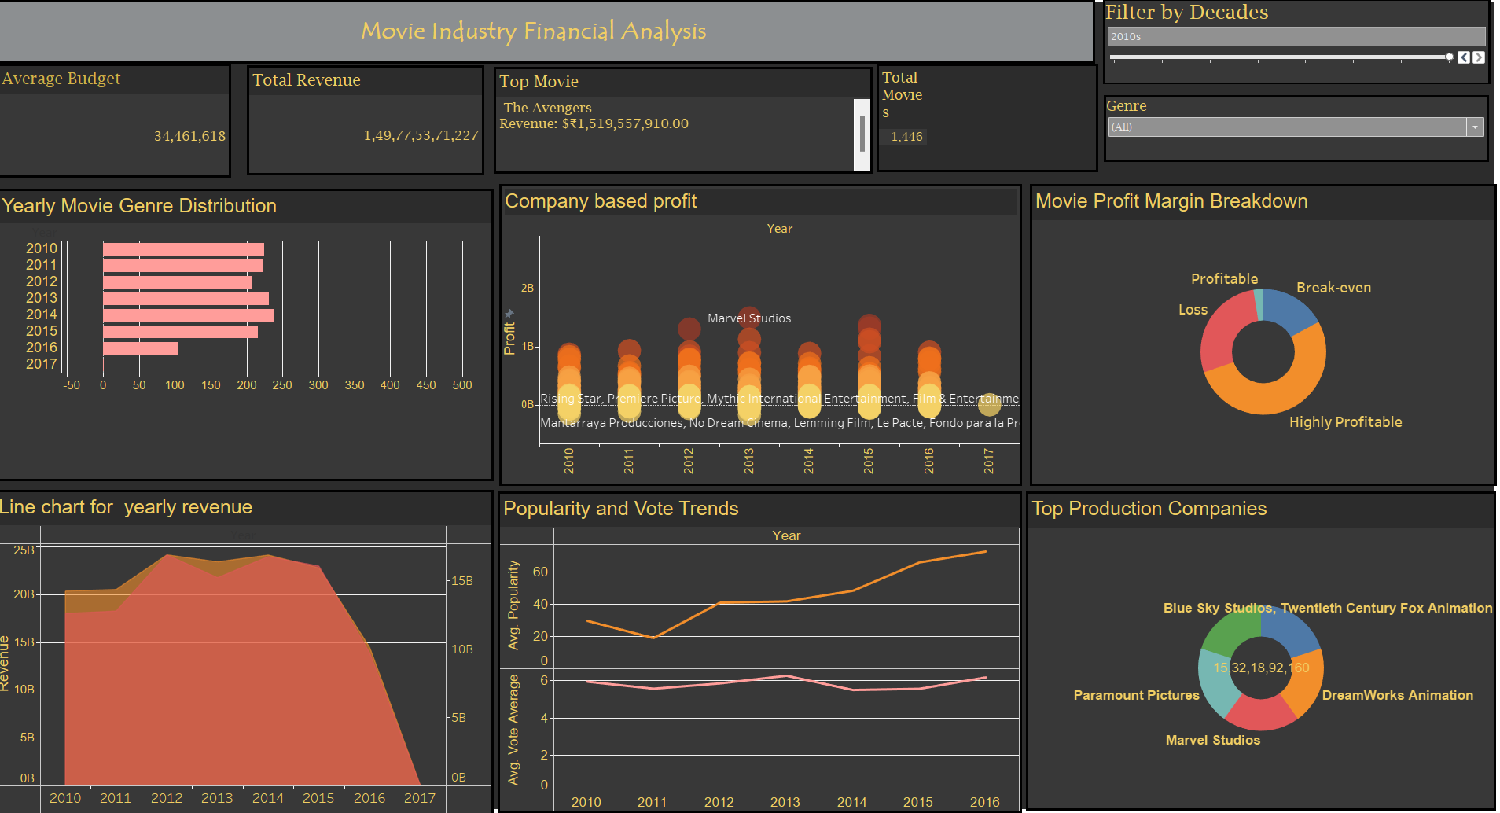

Slide 12
MOVIE INDUSTRY FINANCIAL ANALYSIS BY DECADE
The analysis reveals that while the total revenue generated by the movie industry has grown significantly, the average profit per film has remained relatively stable
The data shows a strong positive correlation between movie budgets and revenues, highlighting the importance of strategic budgeting and genre selection
A select few blockbusters like "Avatar" and "Frozen" have consistently outperformed the industry, providing valuable insights for industry players

Slide 13
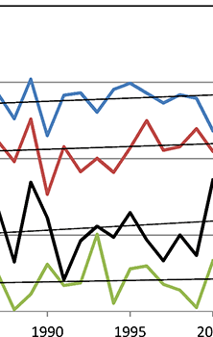
TEMPORAL TRENDS

Slide 14
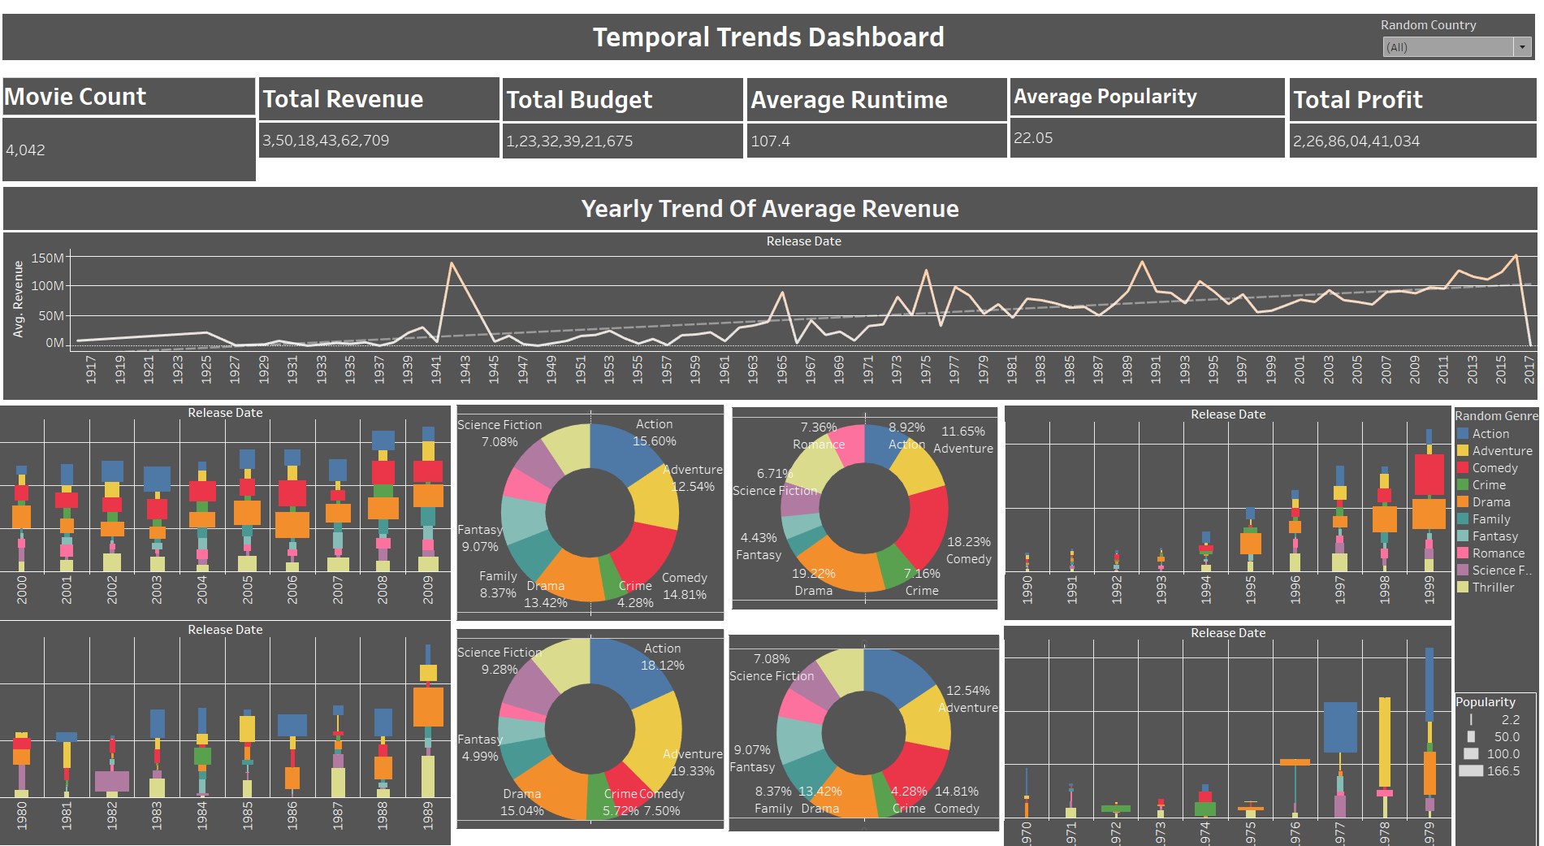

Slide 15
TEMPORAL TREND ANALYSIS
2010s-Present
shift towards more action-oriented genres, with Marvel Studios and other production powerhouses like Columbia Pictures and Paramount Pictures leading the charge.
1970s-2000s
growth of genres like Adventure and Animation, with films like "Psycho" and "Alien" becoming iconic. Production companies like Lucasfilm and Paramount Pictures rose to prominence
1910s - 1960s
rise of classic genres like Drama and Science Fiction, with films like "Intolerance" and "Metropolis" capturing the public's imagination. During this period, the industry began to establish its foundations.

Slide 16

PRODUCTION COMPANY

Slide 17
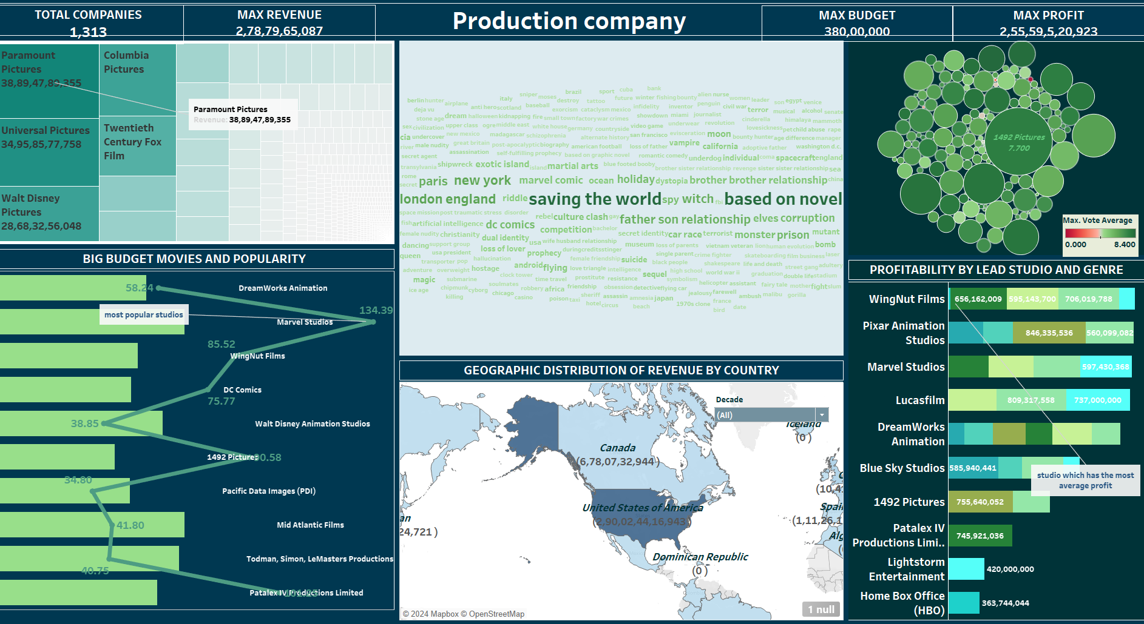

Slide 18
EXPLORING THEMATIC KEYWORDS AND THEIR INFLUENCE ON PRODUCTION COMPANIES OVER TIME
Revenue Leaders
The analysis reveals that Paramount Pictures has consistently been one of the top-performing production companies in terms of total revenue generated
Profitablilty Champions
The data also highlights the success of smaller production companies like 1492 Pictures and WingNut Films, which have achieved impressive profitability by strategically investing in high-return projects.
Audience Favorite
Marvel Studios emerges as the production company with the highest audience engagement, as measured by vote averages and popularity metrics.

Slide 19

AUDIENCE RECEPTION

Slide 20
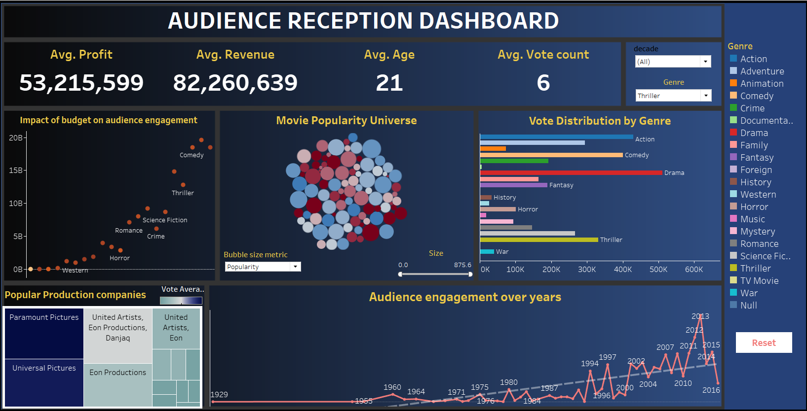

Slide 21
EXPLORING THEMATIC KEYWORDS AND THEIR INFLUENCE ON PRODUCTION COMPANIES OVER TIME
Genre Preferences
Audience preferences have evolved over time, with certain genres like Action, Comedy, and Drama consistently maintaining strong appeal, while others, such as Animation and Science Fiction, have experienced fluctuating popularity.
Popularity Drivers
The analysis reveals that a combination of factors, including budget, production quality, and marketing strategies, can influence a movie's popularity and audience engagement, as measured by metrics like vote counts and average ratings.
Evolving Trends
The analysis reveals a growing trend of movie adaptations based on novels, with production companies like Walt Disney Pictures and Orion Pictures leading the charge in this genre. Movie industry is becoming increasingly globalized, with production companies expanding their reach and targeting diverse international markets

Slide 22




Conclusion
Adaptability
Highlights the importance of adaptability in the ever-evolving movie industry, as production companies must continuously evolve their strategies to cater to changing audience preferences and market trends.
Strategic Investments
The data also underscores the significance of strategic financial investments, as high-budget productions can lead to substantial returns, but only when coupled with a deep understanding of audience preferences and genre trends.
Audience Engagement
Analysis emphasizes the crucial role of audience engagement in shaping the industry's landscape, as production companies that consistently deliver content that resonates with viewers are more likely to achieve long-term success and profitability.

Slide 23
Thank
You

